Slide 1
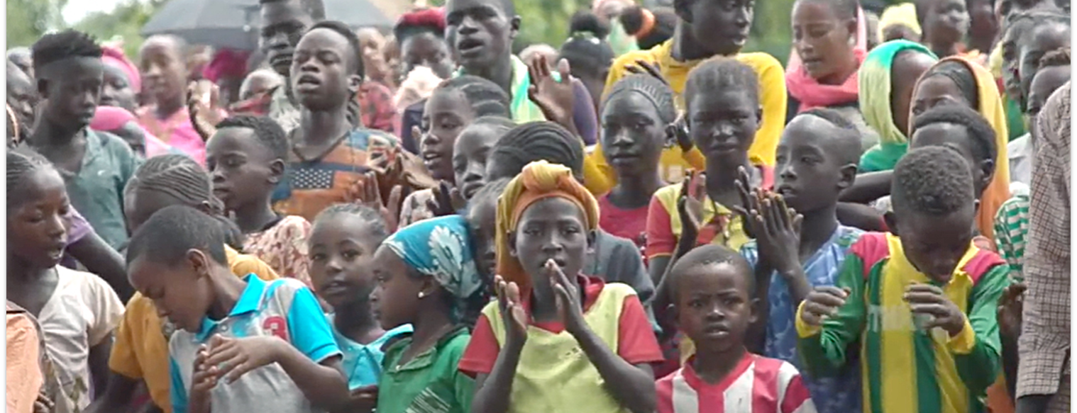
The things that you have heard from me among many witnesses, commit these to faithful men who will be able to teach others also (2 Tim. 2:2).
All Scripture is taken from the New King James Version®. © 1982 by Thomas Nelson, Inc. Used by permission. All rights reserved.
Sharing COBT with Others

Slide 2
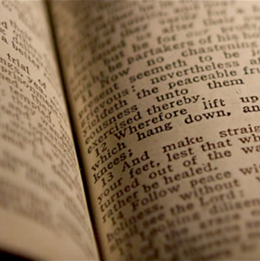
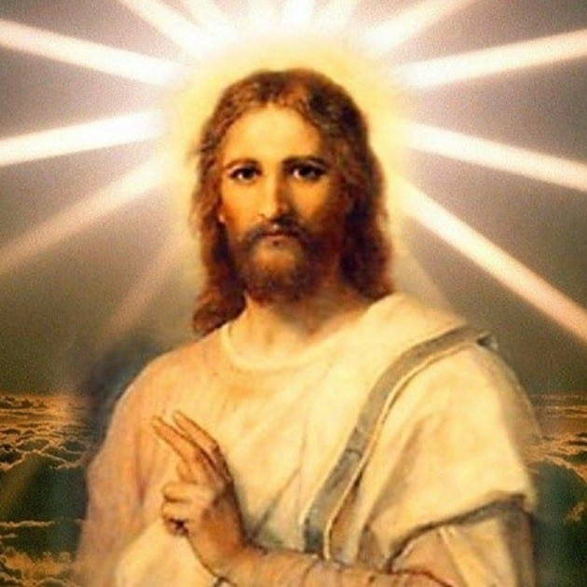
The Great Commission Includes Bible Translation
Go therefore and make disciples of all the nations, baptizing them in the name of the Father and of the Son and of the Holy Spirit, ²⁰ teaching them to observe all things that I have commanded you; and lo, I am with you always,
even to the end of the age.” Amen (Matthew 28:19-20).
Romans 10:17
The Bible
Contains:
The Gospel
The Commands of Jesus

Slide 3
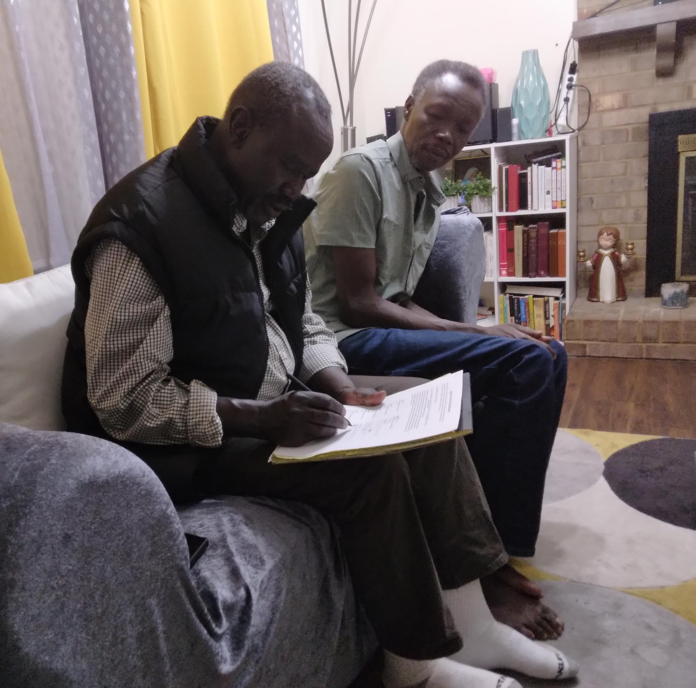
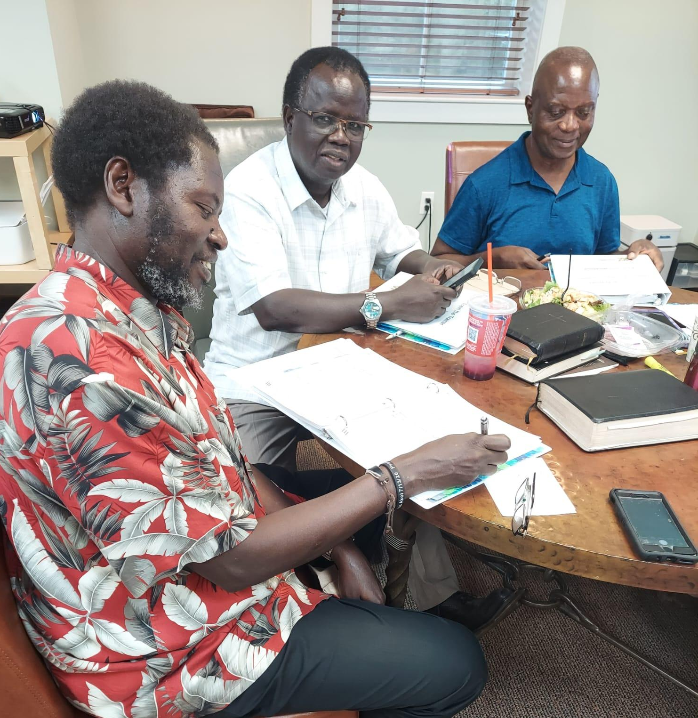
Sharing COBT Experience, Training Others
Identifying, mobilizing, training, and discipling
New Language Groups New Church Partners

Slide 4
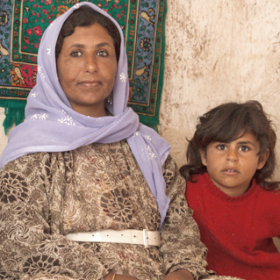
?
Who lives nearby?
Scripture needs
How to help
Other needs in the region / country

Slide 5
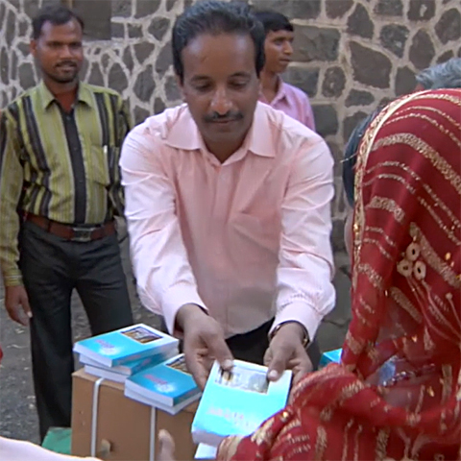
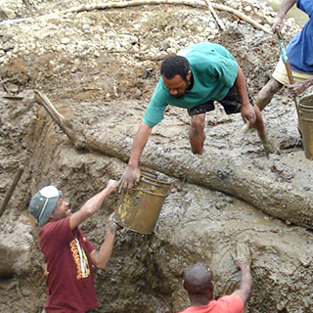
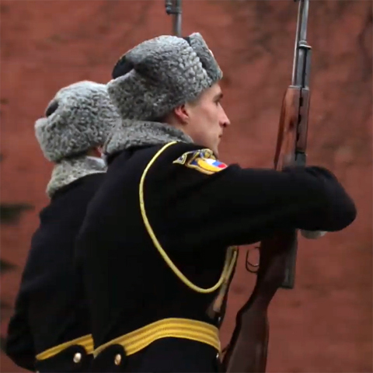
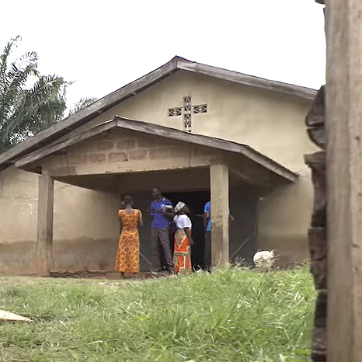
Scripture Changes the Community
Opposition becomes saved souls for Jesus
Neighbors show love and support
Translators risk their lives
People are baptized and join the church

